Slide 1
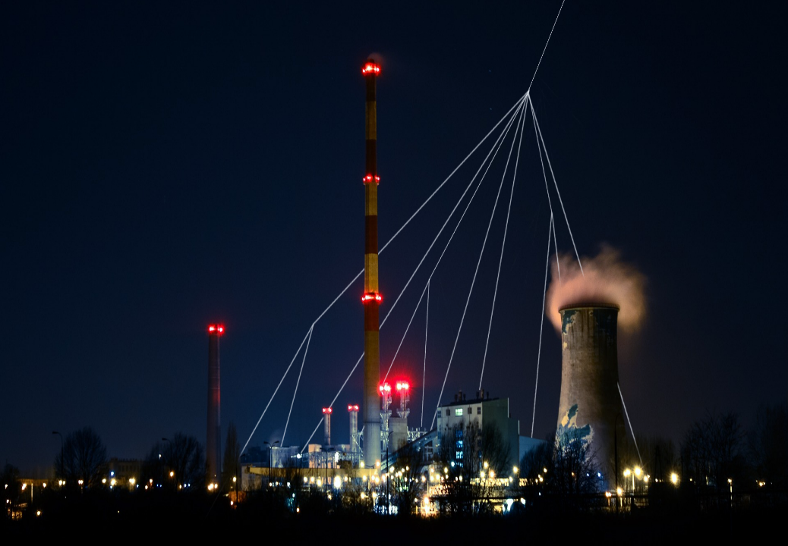




Muon tomography
Scientific Computing Workshop for High Energy Physics and Tomography
16-20 December, VECC, Kolkata, India
P. Martínez Ruiz del Arbol
parbol@ifca.unican.es

Slide 2
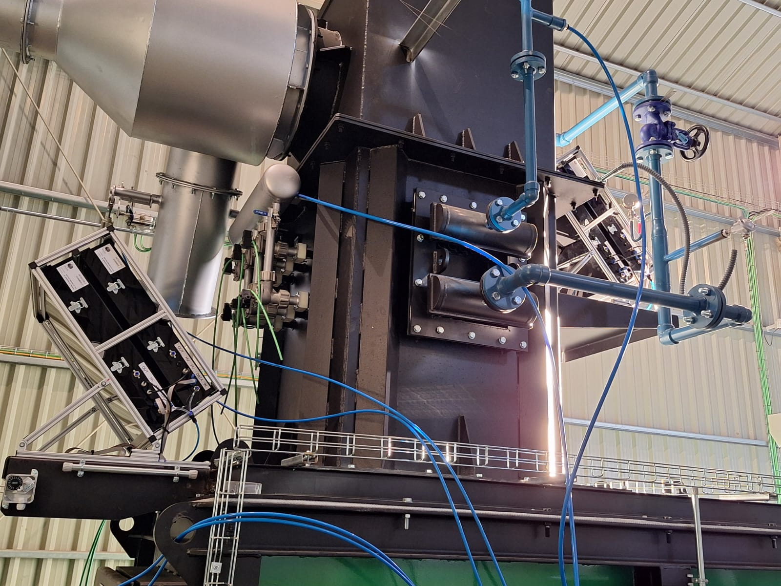
Outline
Muon tomography: concept and principles
Some classic (and not so classic) applications
How does it work?: Muon detectors
How does it work?: Muon imaging
Going beyond: Artificial Intelligence
Hands-on exercise

Slide 3
Outline
Muon tomography: concept and principles
Some classic (and not so classic) applications
How does it work?: Muon detectors
How does it work?: Muon imaging
Going beyond: Artificial Intelligence
Hands-on exercise
Disclaimer
In this lecture I will show results from different groups around the world
However you will observe some bias towards developements in my group
Those are the ones that I know the best
I have added references when available (please, use them!)

Slide 4
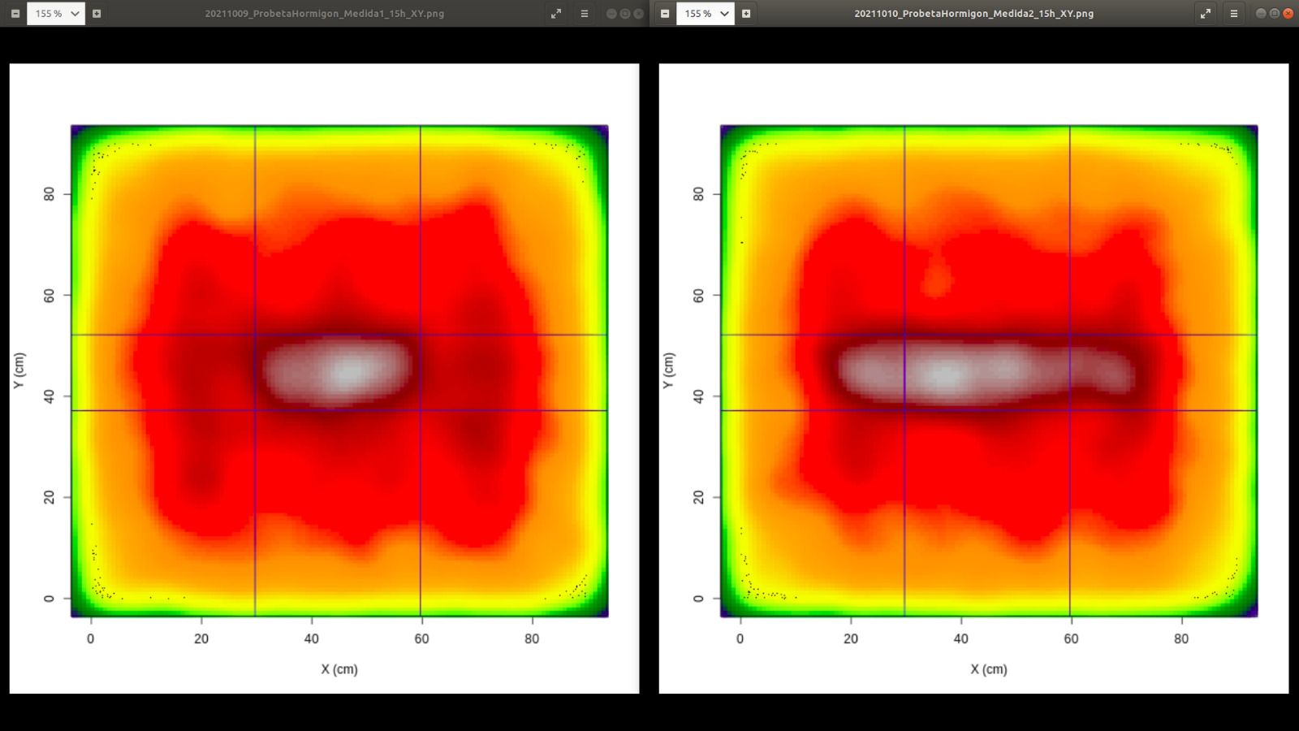
Muon Tomograpy:
Concept and principles

Slide 5
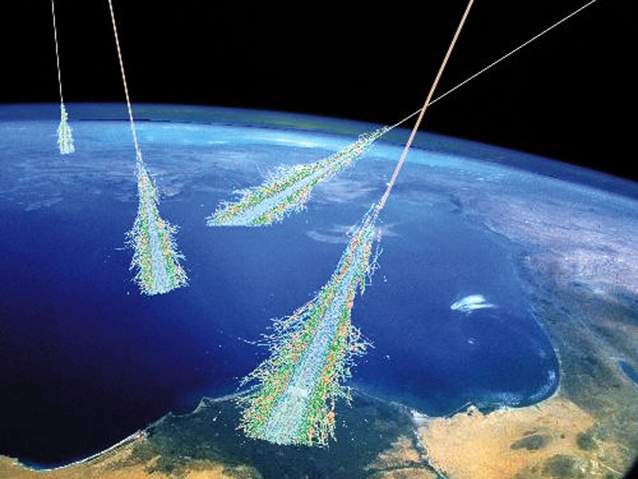
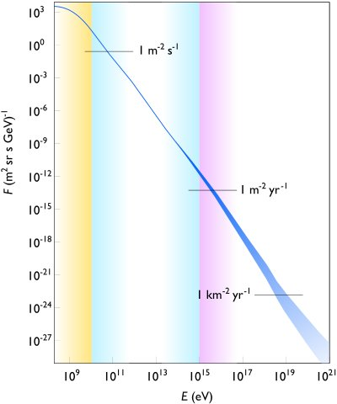
Cosmic rays: origin and composition
Constant flux of high energy particles bombarding the Earth from outer space
Composed mainly by protons (98%), alpha particles (~2%), and other particles (< 0.1%)
Cosmic rays are the most energectic particles observed so far
The Oh-My-God Particle 3x10⁸ TeV (1991, several since then)
https://en.wikipedia.org/wiki/Oh-My-God_particle

Slide 6
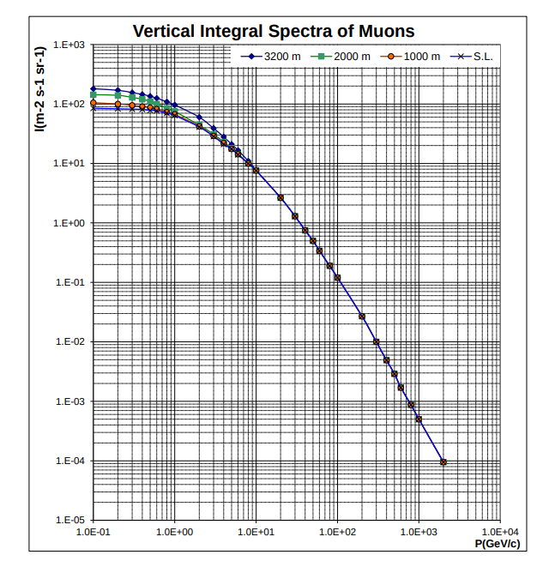
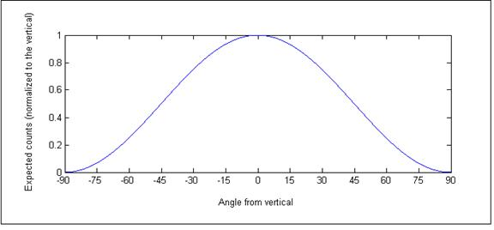
Cosmic muons: flux, energy spectrum
Muons are generated mostly from pion decays in the upper layers of the atmosphere
The flux of muons is roughly proportional to cos²(Θ) (angle with respect to the vertical)
Quickly falling spectra -> average of about 3 GeV when integrating to the full solid
Rule of thumb at sea level:
10000 muons per squared meter and minute

Slide 7
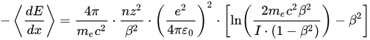
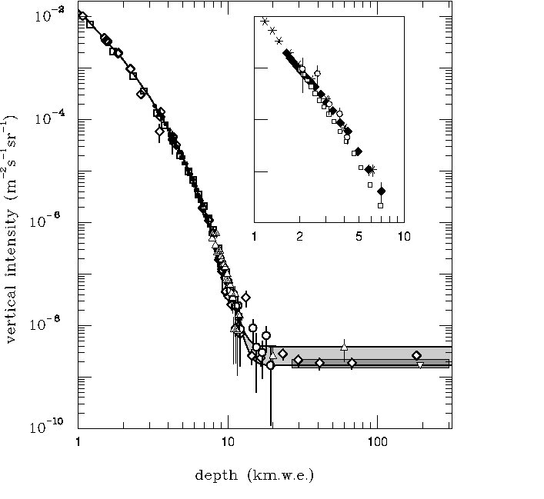
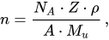
Muon interactions with matter: ionization
Ionization is one of the most frequent processes undertaken by cosmic muons when crossing matter
The energy loss depends on the Z, density, mean excitation potential and the size of the crossed object.
The Range is the distance for which the particle looses all its energy (and dissappears)
Mean excitation potential
Muon Energy/GeV | Material | Range/m
1 | Water | 471
10 | Water | 4260
1 | Concrete | 228
10 | Concrete | 2025
1 | Standard Rock | 209
10 | Standard Rock | 1857

Slide 8
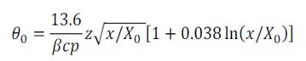
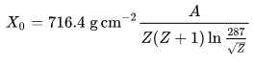
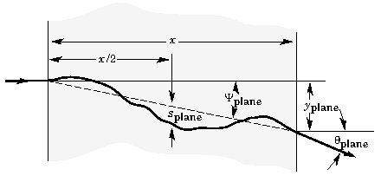
Muon interactions with matter: multiple scattering
Coulomb scattering deviates the direction of the muons when crossing matter
Scattering angle depends also on the Z, density and size of the material
The angular distribution of the deviation is approximately gaussian (with some longer tails)
Muon momentum dependence
Muon Energy/GeV | Material | Width/cm | Angle/mrad
1 | Iron | 1 | 10
10 | Iron | 1 | 1
1 | Iron | 10 | 34
10 | Iron | 10 | 3
1 | Lead | 1 | 19
10 | Lead | 1 | 2
1 | Lead | 10 | 64
10 | Lead | 10 | 6
1 | Uranium | 1 | 26
10 | Uranium | 1 | 3
1 | Uranium | 10 | 88
10 | Uranium | 10 | 9
Radiation length

Slide 9
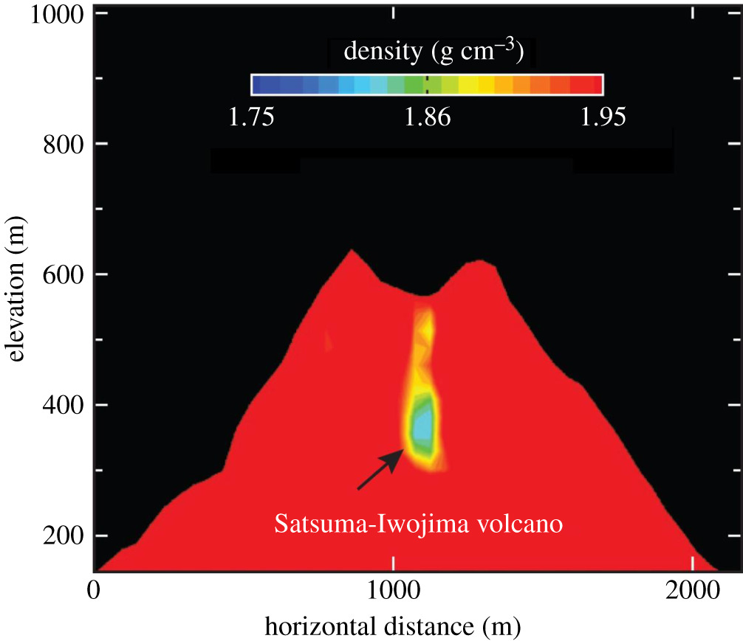
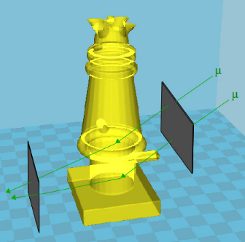
Muon Tomography
The attenuation and deviation of muons depend both on the properties of the materials crossed
These processes can be used in order to infer and/or image the traversed objects
This technology becomes a Non-Destructive Testing (NDT) technique with multiple applications
Absorption muon tomography
Muon flux measured vs direction (attenuation)
One single detector needed
Need large object + long exposure times
Typical applications: geology, volcanology, etc
Scattering muon tomography
Muon angular deviation (scattering)
Two detectors needed
Small-medium size objects + short exposure times
Typical applications: border security, nuclear, etc

Slide 10
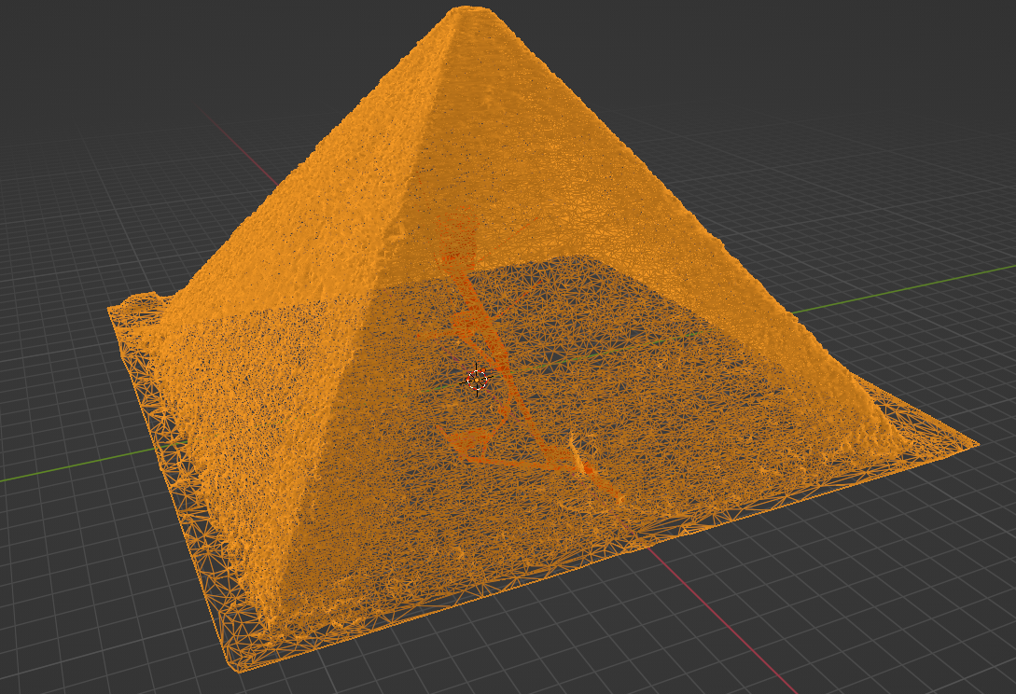
Some classic
(and not so classic) applications

Slide 11
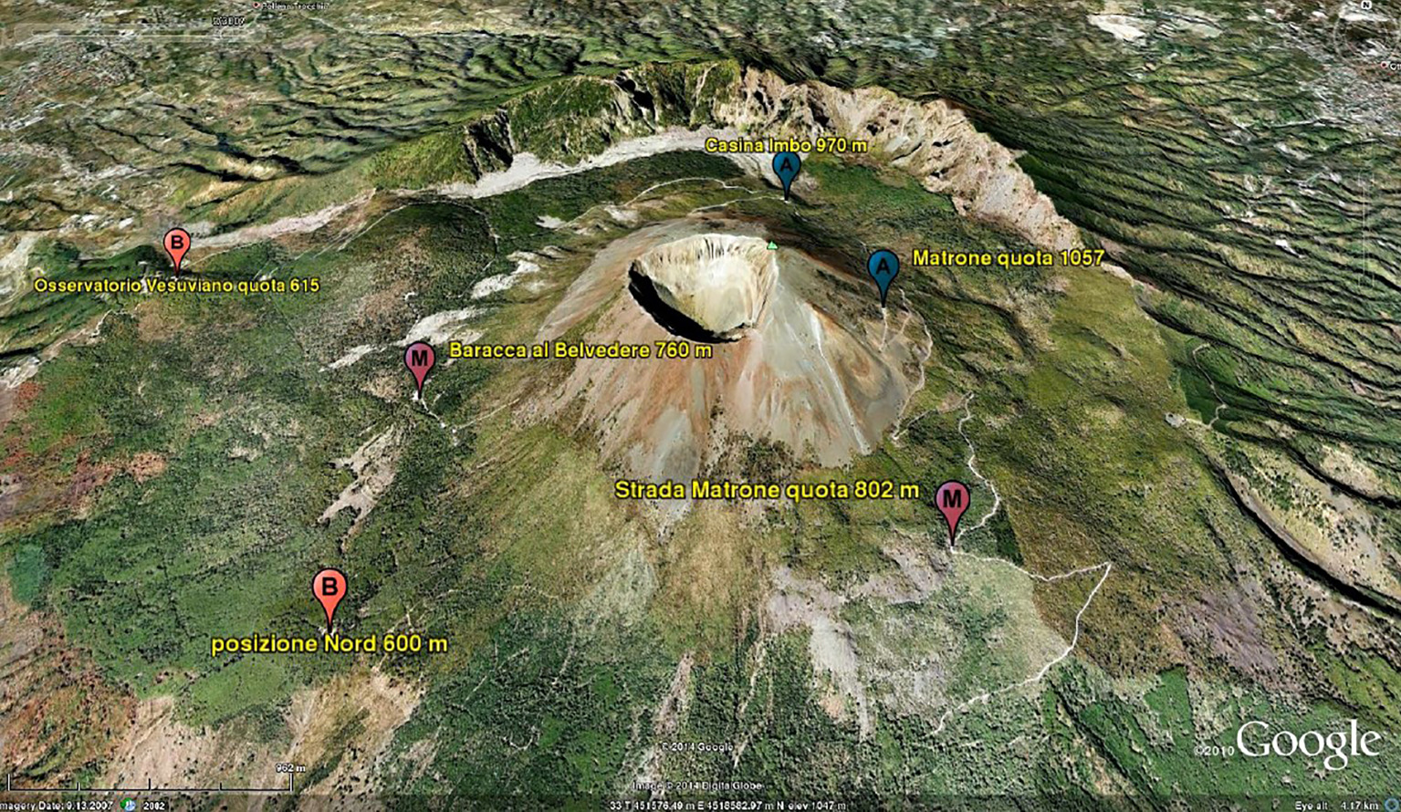
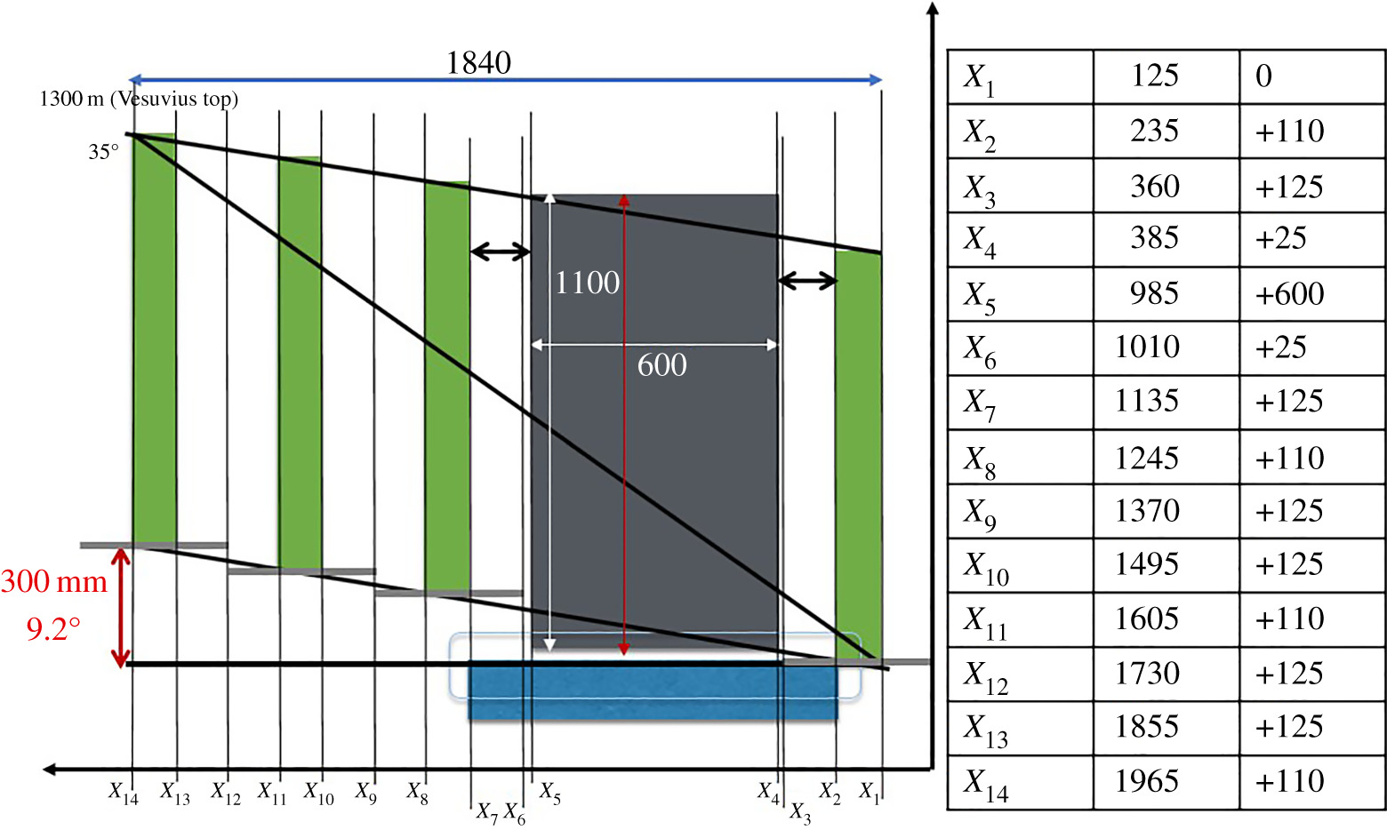
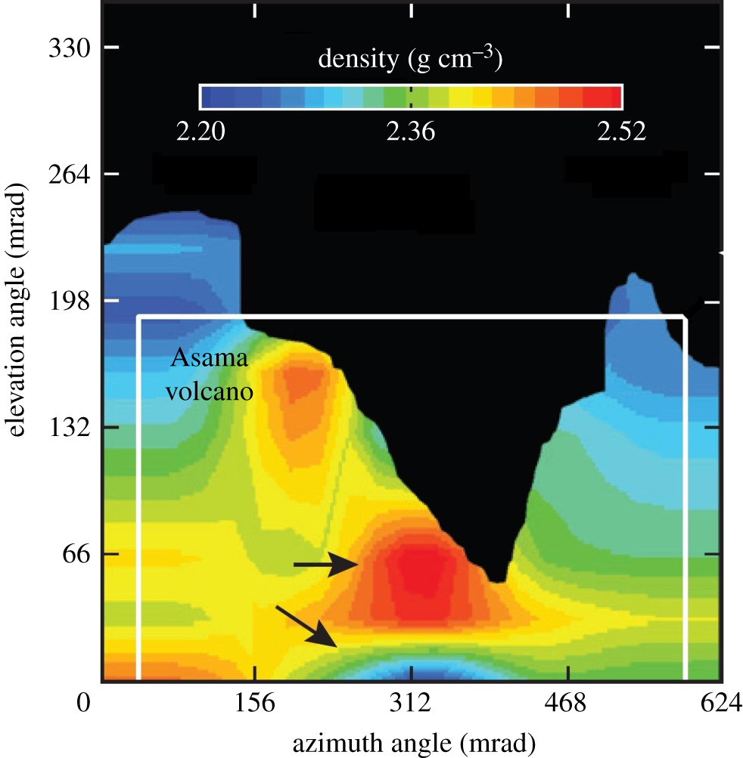
Application to volcanology
Monitoring of Vesuvious volcano in Italy
https://doi.org/10.1098/rsta.2018.0050
Monitoring of Asama & Iwujima volcanos in Japan
https://doi.org/10.1098/rsta.2018.0142
Exposure time ~ 1 year
Dinamic studies on magma convection

Slide 12
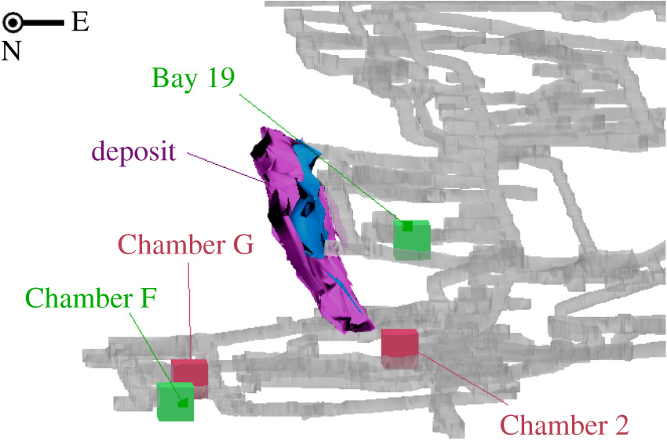
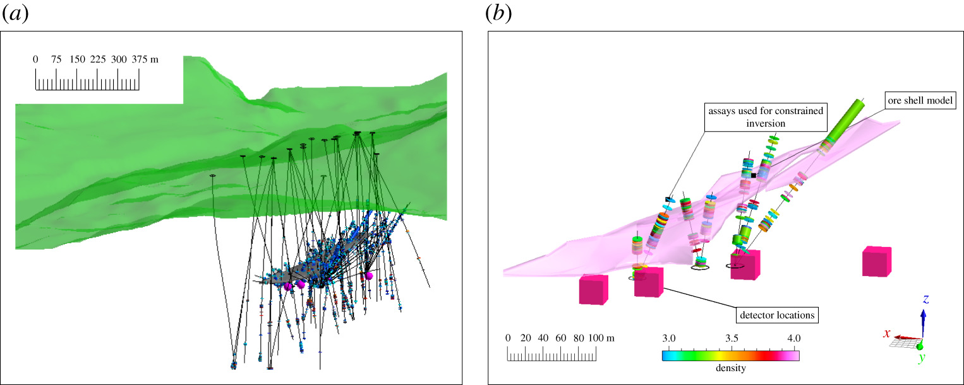
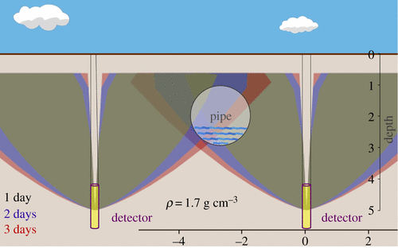
Application to mining/prospection
Search for uraunium/lead clusters in McArthur River (Canada) and Pend Oreille (USA)
https://doi.org/10.1098/rsta.2018.0061
Ideon Technologies
Grid of scintillator detectors underground
Detection of hidden cavities undergound
Lingacom S.L
Cylindrical detector in borehole

Slide 13
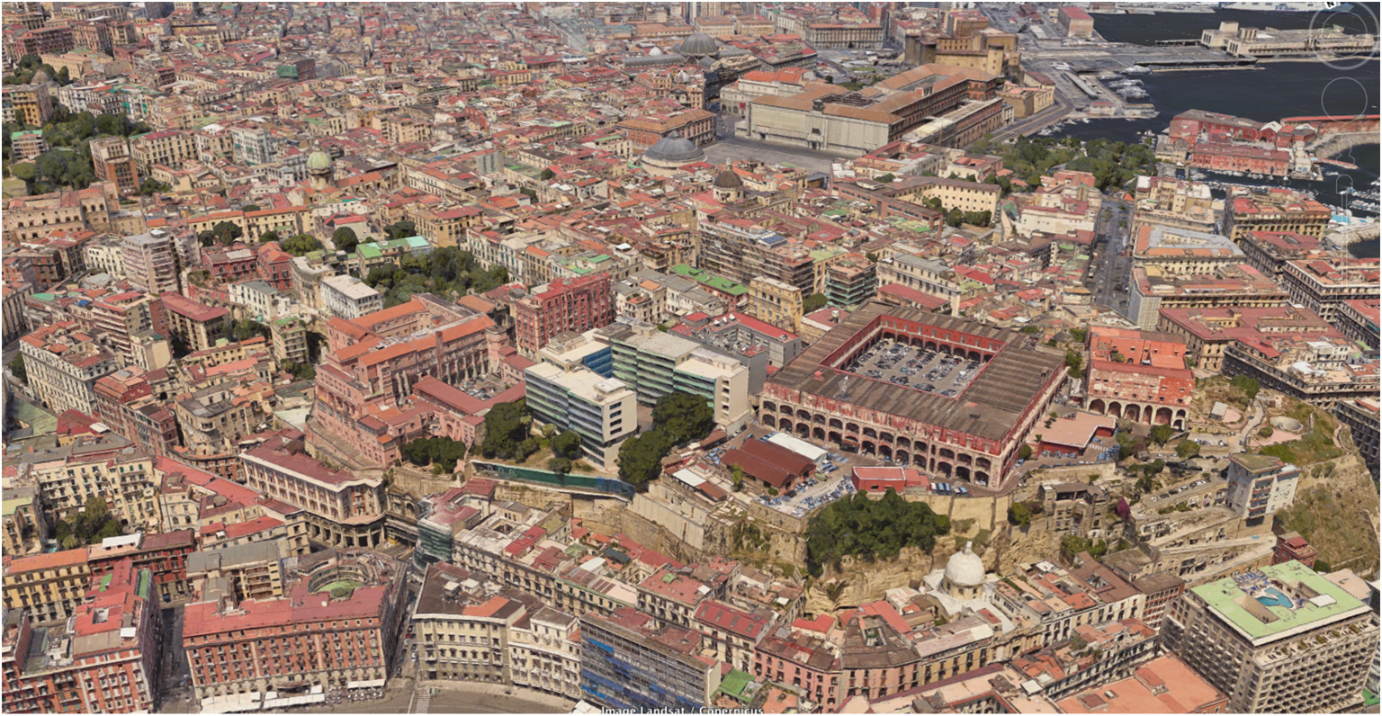
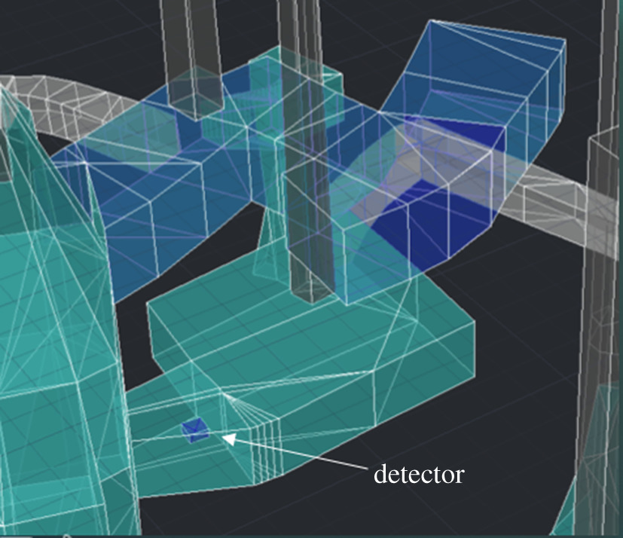
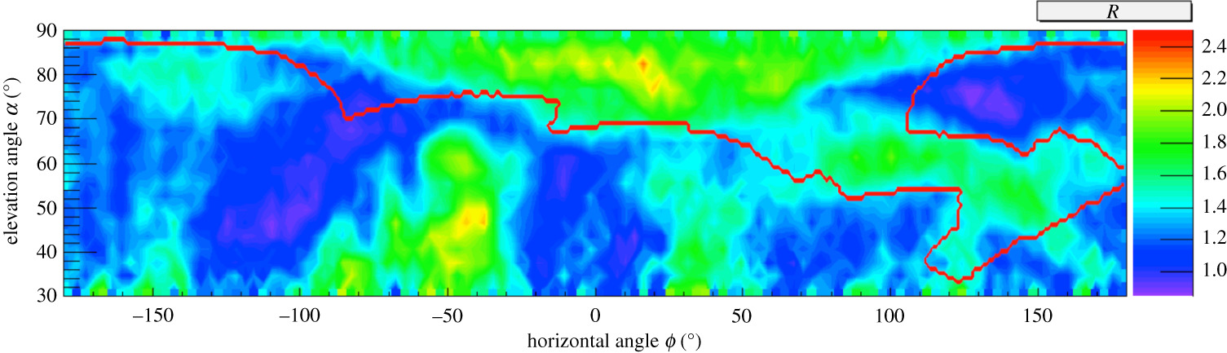

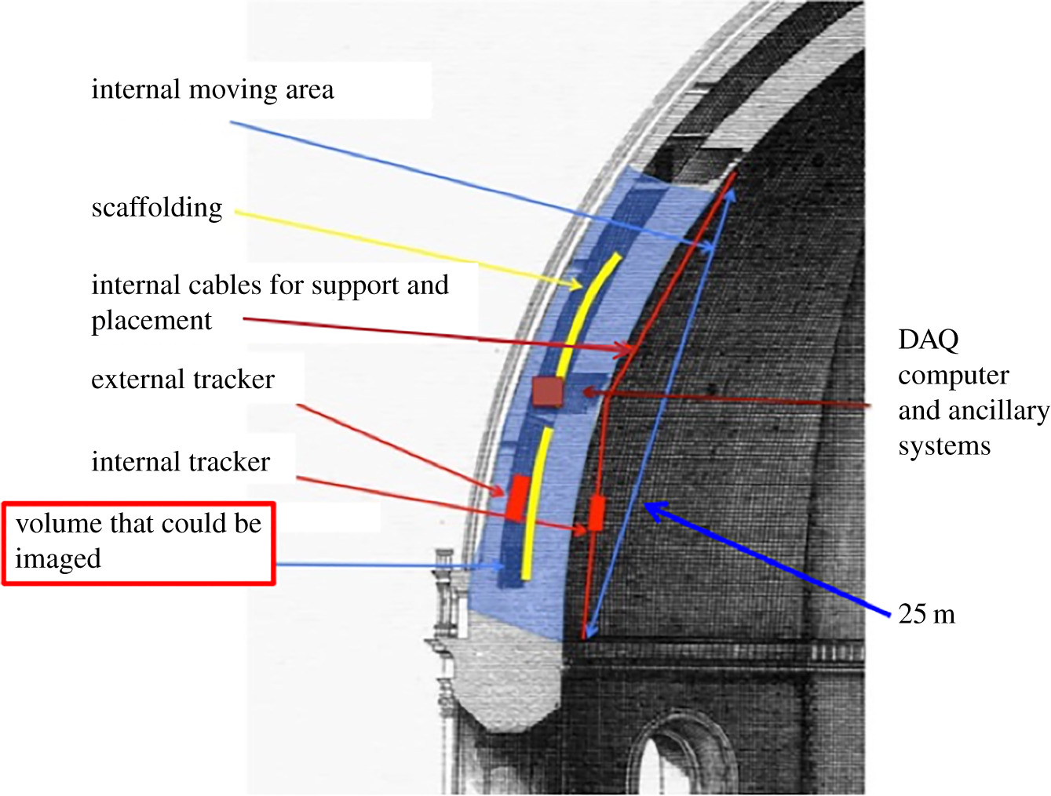
Application to archeology/cultural heritage
Search for secret galleries at Mount Echia (Borbon tunnel)
https://doi.org/10.1098/rsta.2018.0057
Just one scintillator detector at different positions
26 days of data taking
Detection of hidden cavities undergound
Monitoring of the dome of Santa Maria de Fiore
https://doi.org/10.1098/rsta.2018.0136
Scattering tomography
Drift tube chamber technology

Slide 14
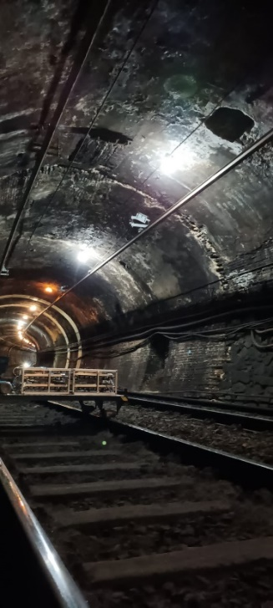
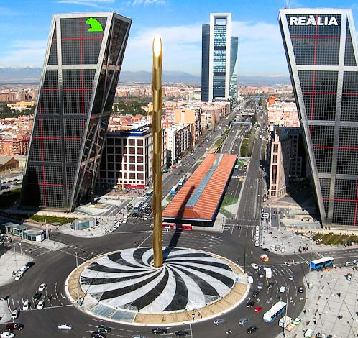

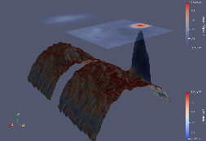
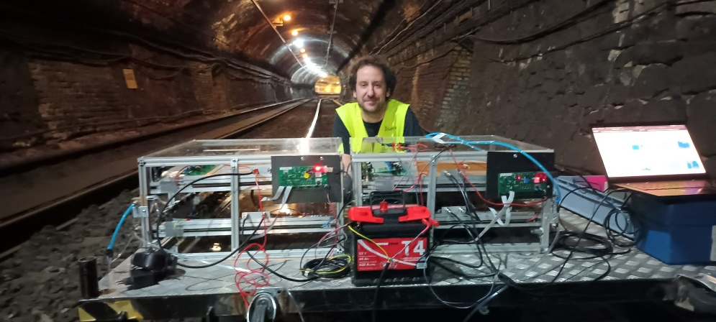
Civil engineering: tunnel inspection
Identification of ventilation tube at the metro of Madrid
Ventilation tube

Slide 15
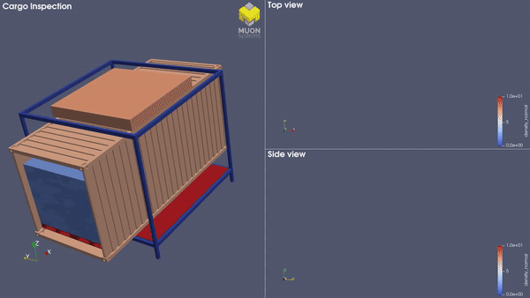
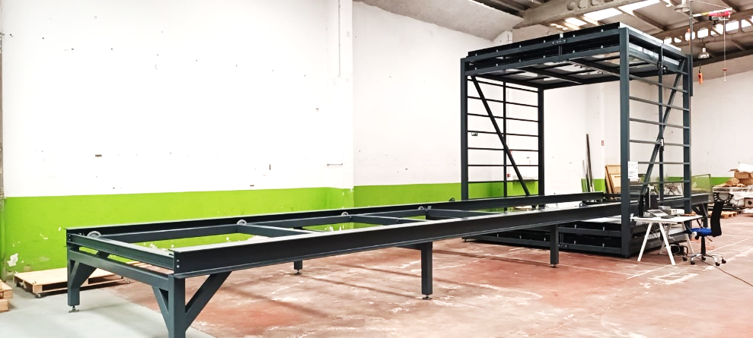
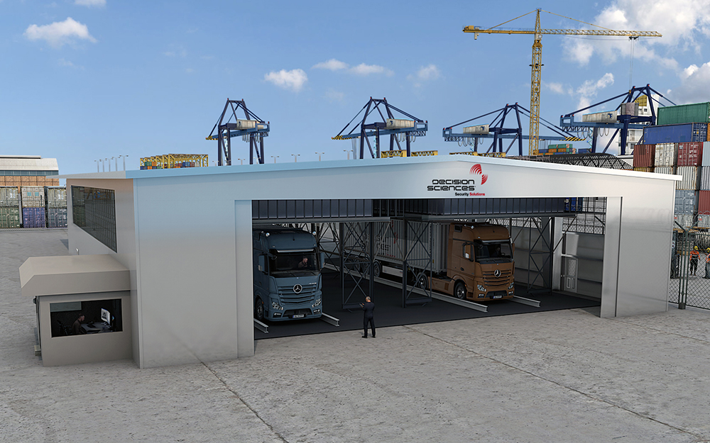

Application to port security
Inspection of containers in ports and borders
Muon Systems S.L.
Building portal in the port of Santander
Multiwire Proportional Chambers
Modular design + AI methods
Detection of hidden cavities undergound
Muon Cargo 3m x 3m container scanner
Decision Sciences
Portals installed in Singapur and Panamá
Drift Tube Chambers

Slide 16
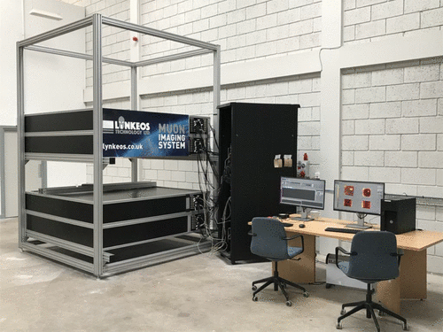

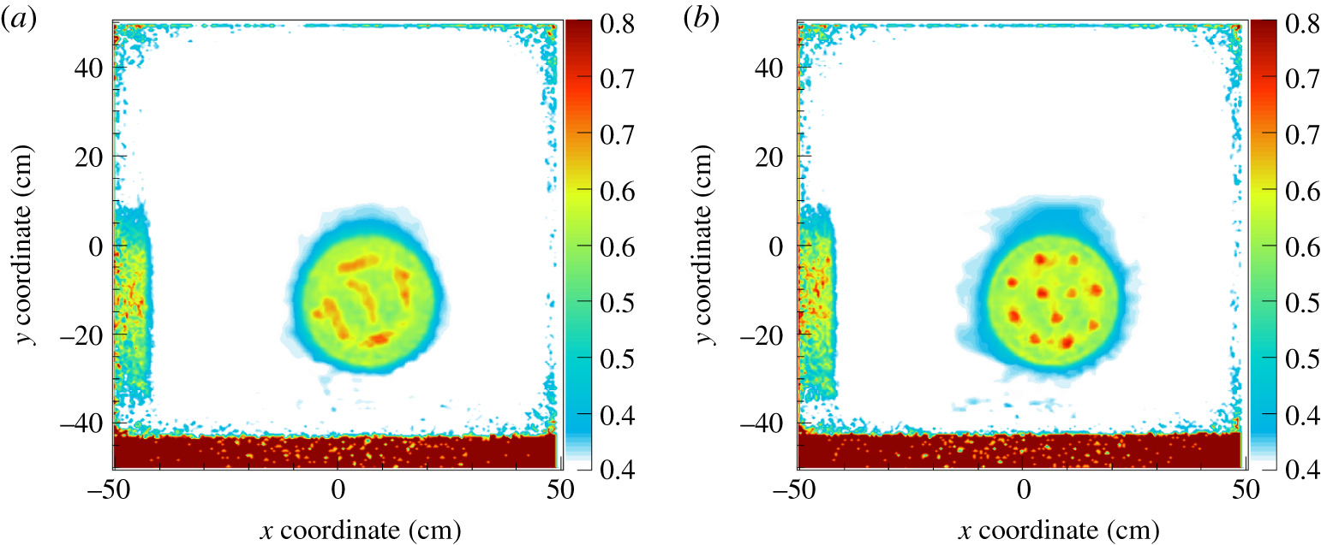
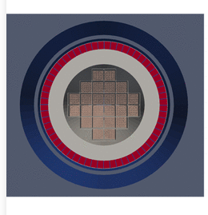
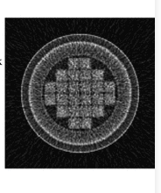

Application to the nuclear industry
Nuclear waste characterization
Linkeos Technologies
UK nuclear decommissioning authority
Scintillator detectors
https://doi.org/10.1098/rsta.2018.0048
Fuel cask monitoring
https://doi.org/10.1098/rsta.2018.0052
16

Slide 17

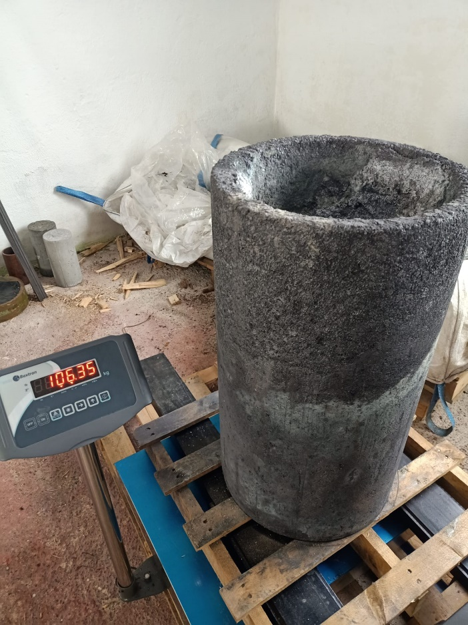
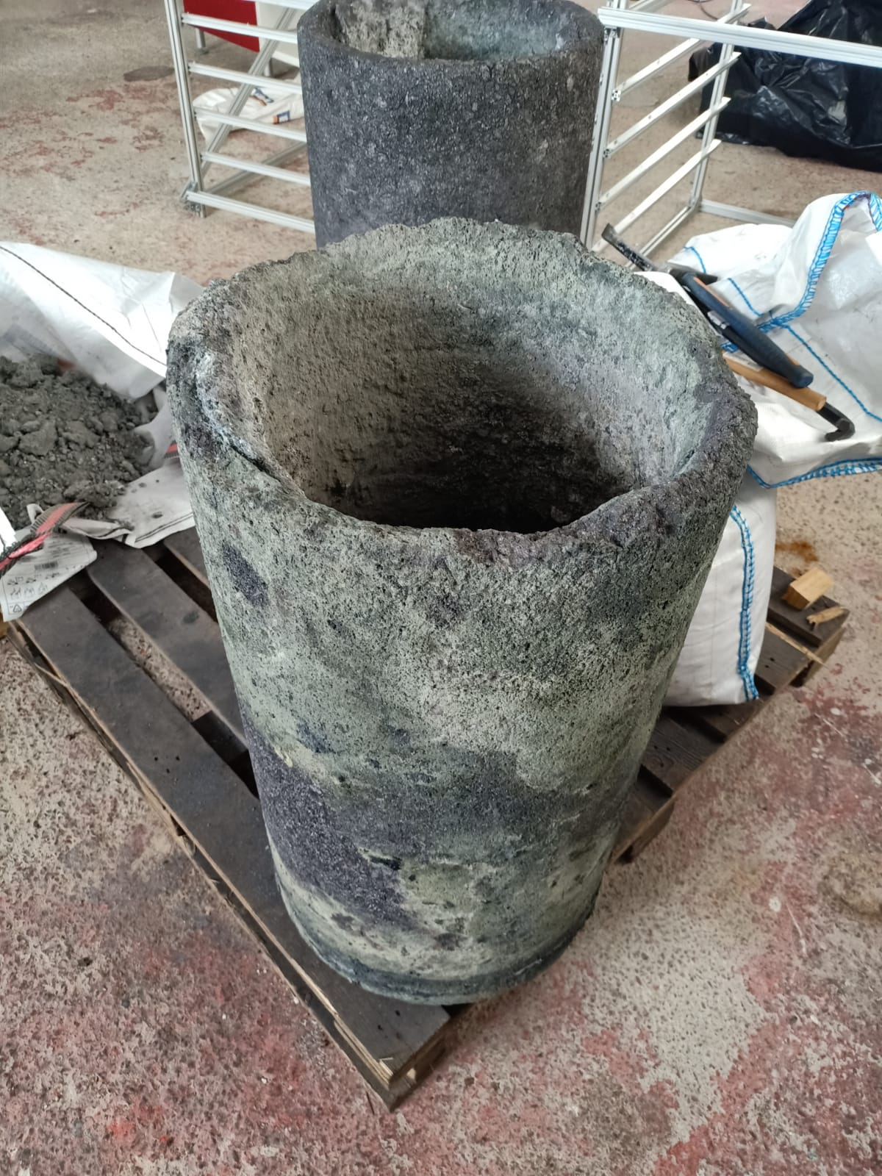
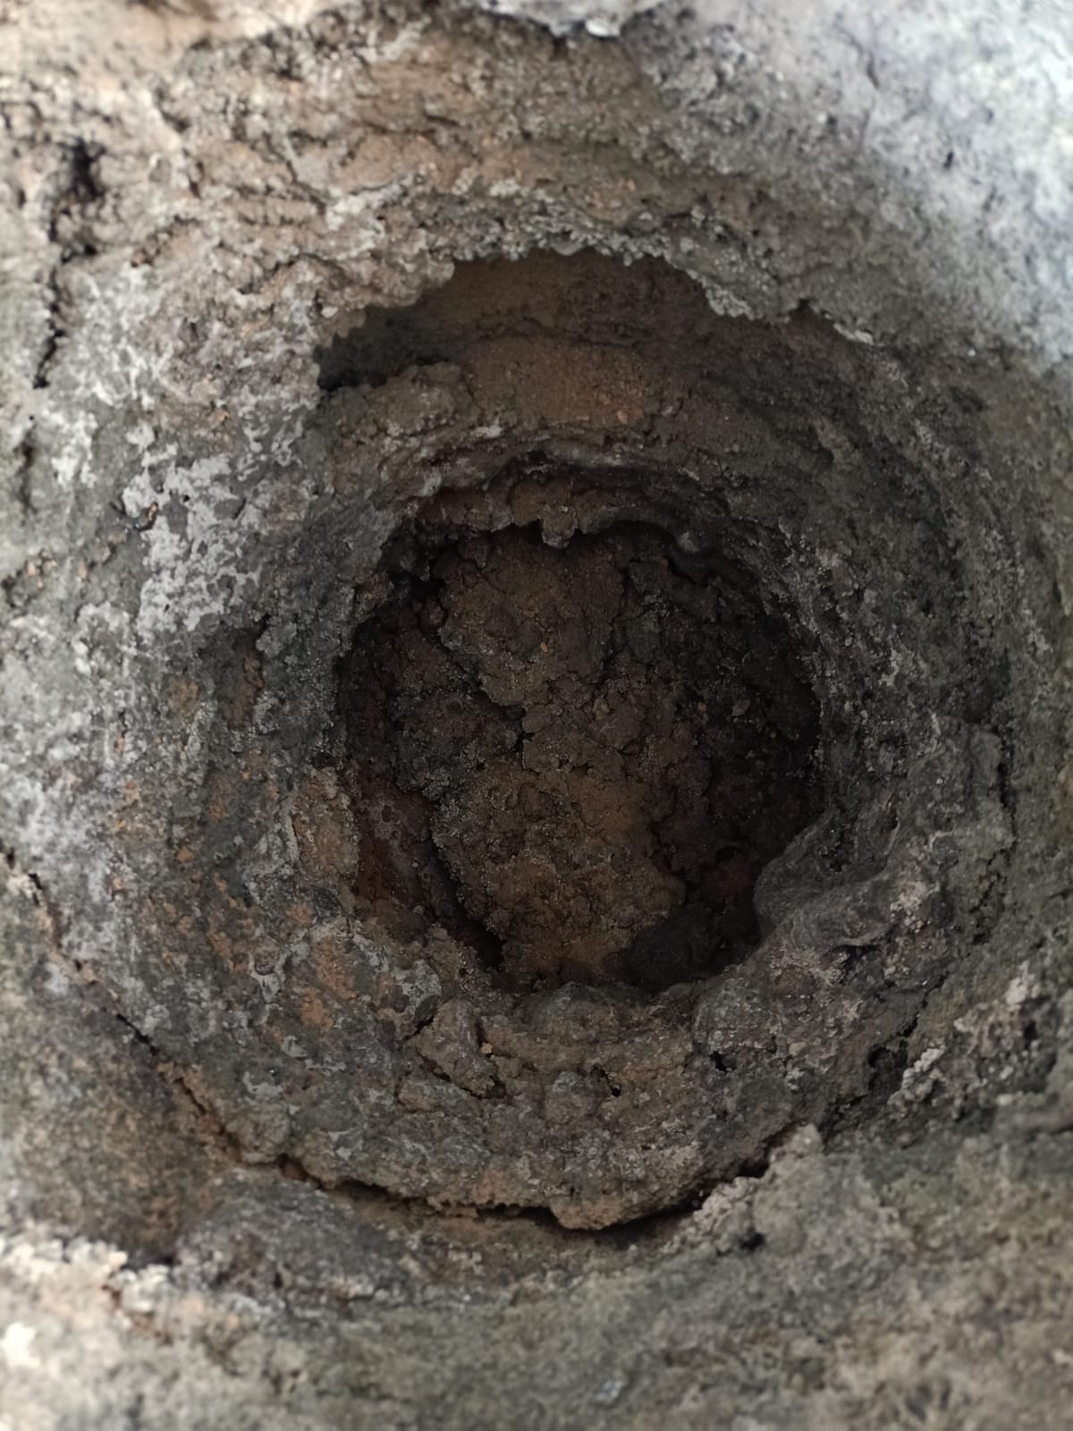
Application to industry: furnace integrity
Inspection of the degradation of the crucible of an arc voltaic furnace for melting silicon
Two competing effects due to chemical reactions: wear but also new solid material attached to the walls
This is particularly important at the bottom of the crucible
Almost perfect crucible
Used crucible
Detail of the bottom

Slide 18
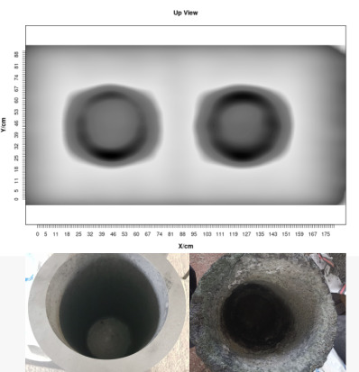
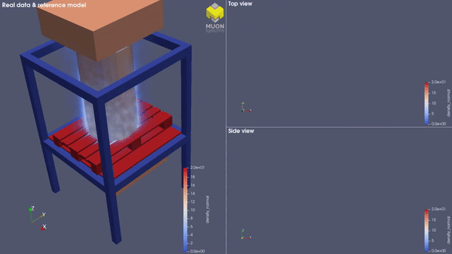
Muography in the industry: furnace integrity
The accumulation of material can be clearly seen in the images specially in the walls
Tomography analysis reveals also the large accumulation at the bottom of the furnace
Length of the data taking: 24 hours (for vertical configuration)
Measurements done in the lab (shown here) and also on site (anaysis is in progress)
3D reconstruction of damaged furnace

Slide 19
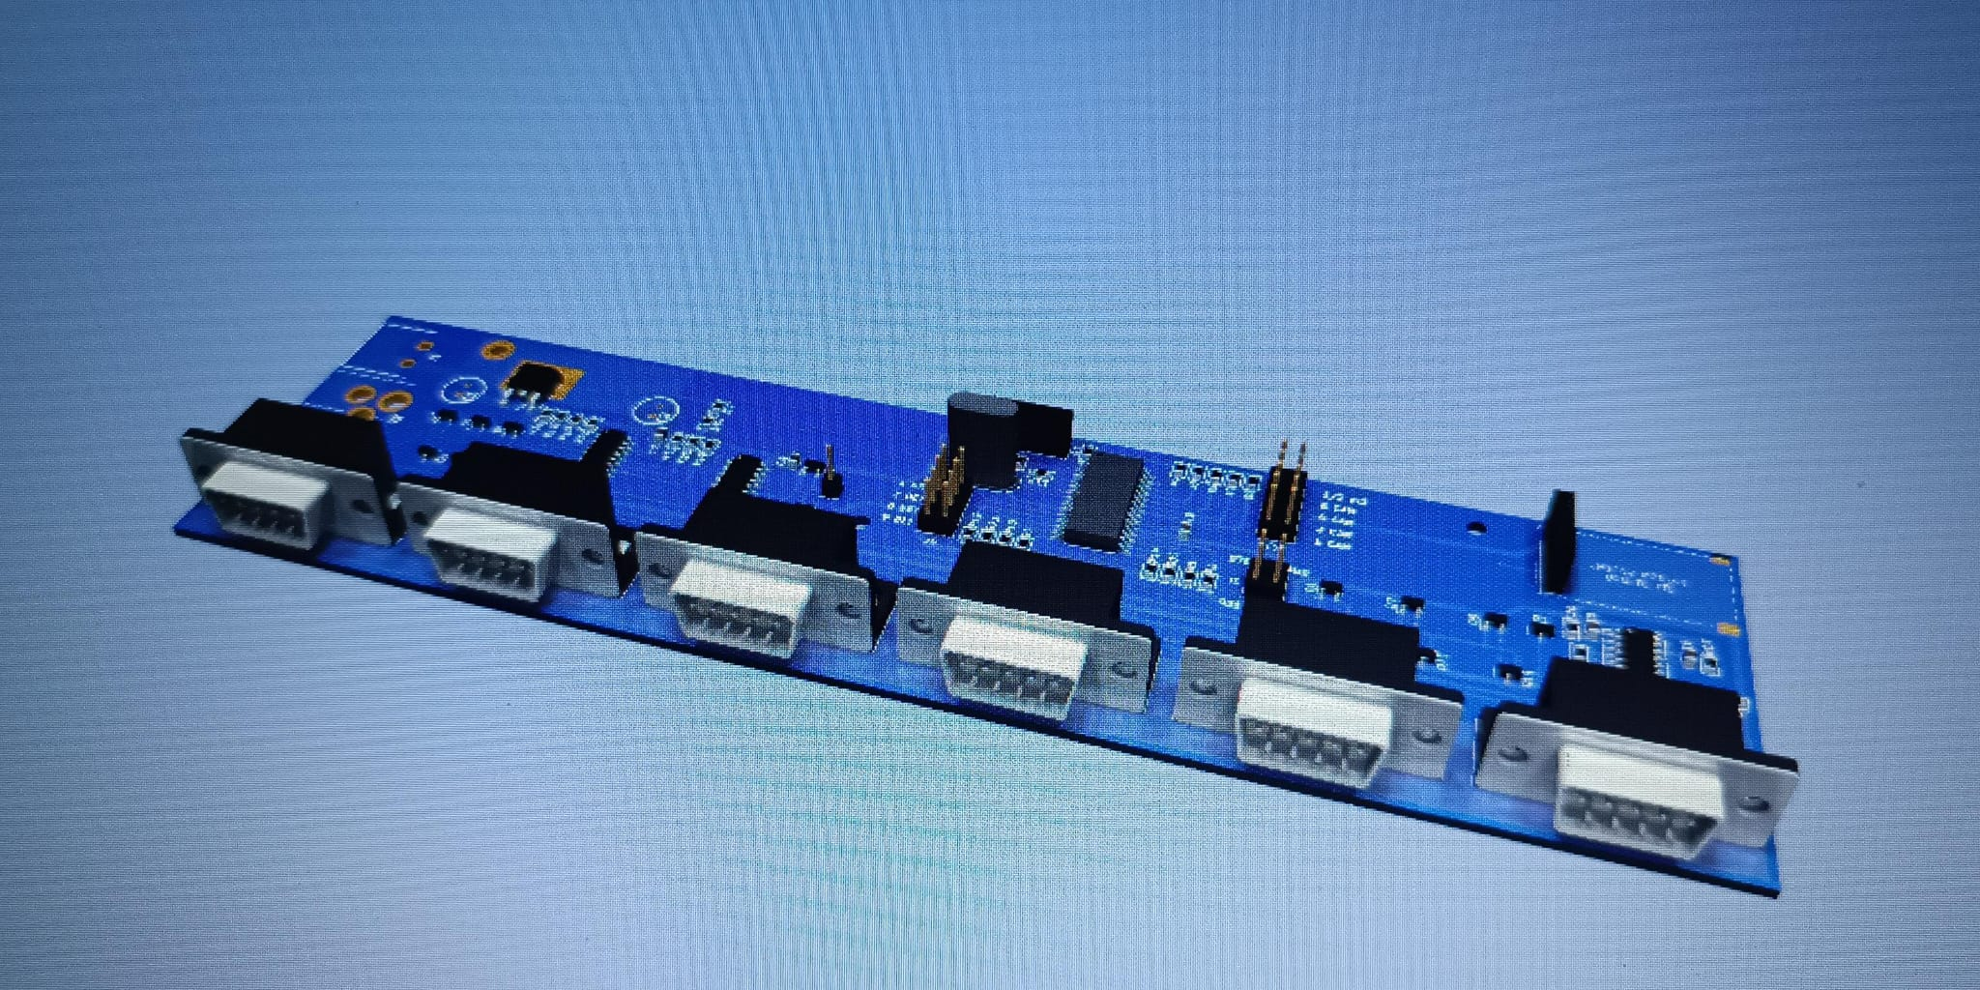
How does it work?: Detectors

Slide 20
Detectors for Muon Tomography
Muon detectors in muography need to match several requirements
Requirements related to the quality of the technique
High granularity to provide good spatial resolution for the muon hits and trajectory
High angular resolution (different planes have to be far enough so direction is precisely estimated)
Requirements related to the applicability of the technique
High acceptance to not extend too much the exposure times
Capacity to work in harsh environments (high temperature, dust, gases, rain …)
Cost effectiveness
Most of the applications nowadays use one of the following techniques
Scintillator detectors
Emulsion detectors
(only for a few applications, not covered here)
Gas detectors

Slide 21
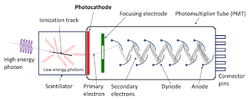
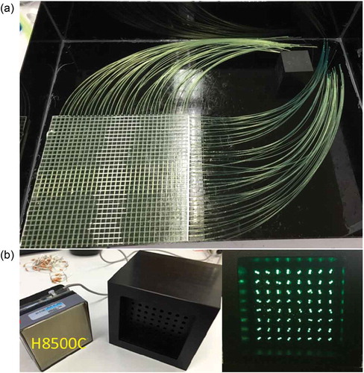
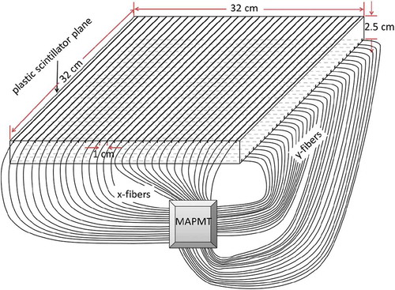
Scintillator detectors
Charge particles, including muons, produce light when crossing a scintillator material
The light is collected by a photomultiplier (a classic one or more recently a SiPM)
There are many different kinds of scintillators and they can be arranged in variety of shapes
One particularly interesting case for muon tomography is scintillator fibers
These fibers can be arranged in grids and provide good resolution in both X and Y coordinates
https://doi.org/10.1080/00295450.2018.1522885

Slide 22
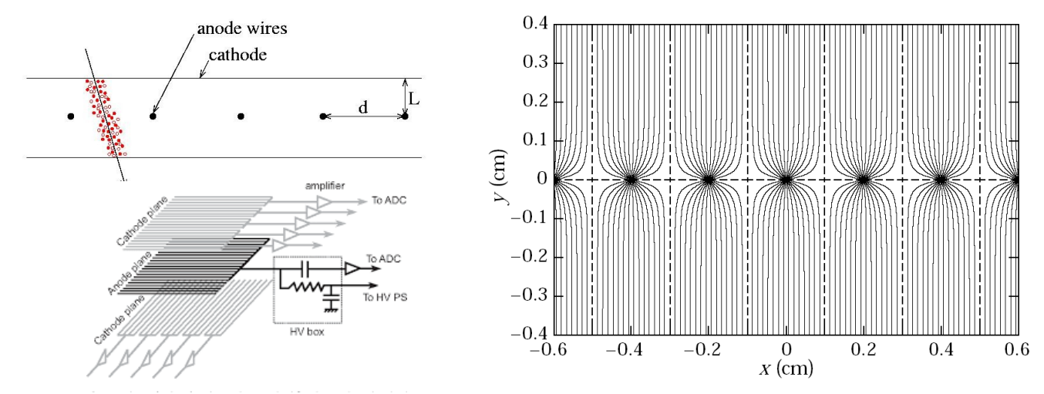
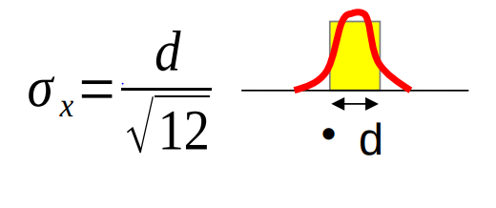
Multiwire proportional chambers
Ions generated by the muon in the gas drift towards the field lines (electrons to wires, ions to planes)
These detectors only measure one coordinate so usually planes are stacked with a 90º rotation
If a muon only produces charge in one wire the resolution is given by the spacing between wires
If more tan one wire is activated -> better resolution

Slide 23
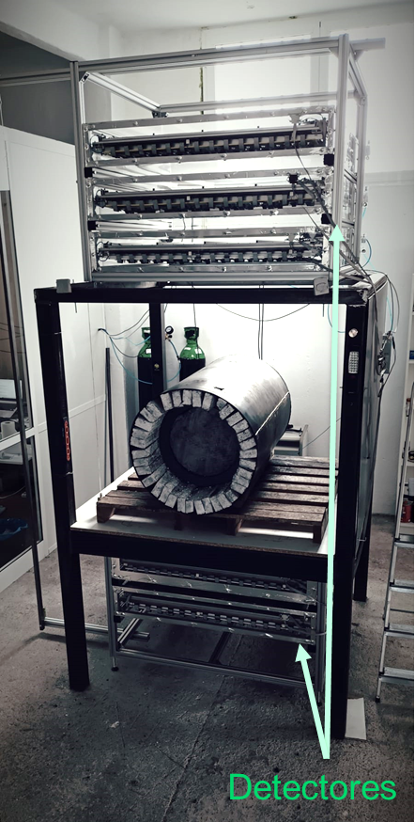
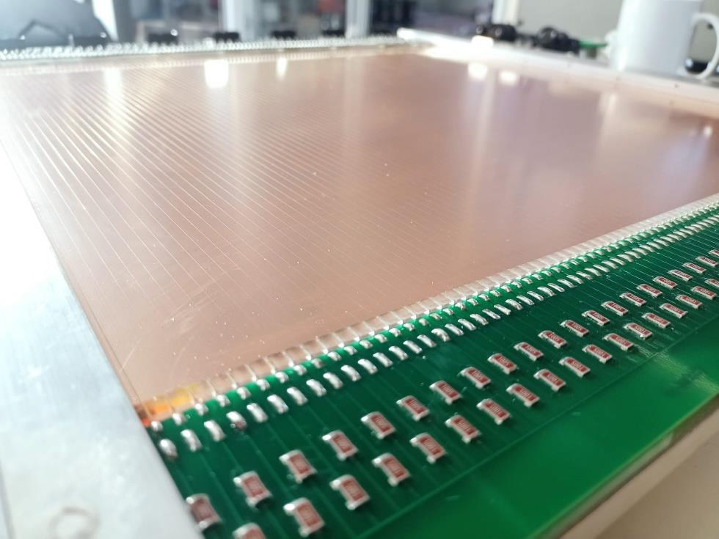



Multiwire proportional chambers
Technology based on Multi-Wire Proportional Chambers with custom ASICs and readouts
Detectors have great efficiency (95% per layer) and great stability (intelligent gas management system)
Each layer is instrumented on both sides with orthogonal wires to measure X and Y
Muon detectors
Readout ASICs
Concentration card (per layer)
Master (Trigger + DAQ)

Slide 24


Multiwire proportional chambers
Protective cover and compact and hermetic control capsule
Gas and cable connections completely isolated using specific cable isolation standards (Weipu)
Capability to operate in environments with rainfalls, gases, dust, etc
Adjustable inclination
Control system

Slide 25

Multiwire proportional chambers
Power distribution system
Electrovalve control system
High voltage
Electrovalve
Control PC
(Wifi + HD)
Trigger + DAQ (Master)

Slide 26

How does it work?
Muon Imaging

Slide 27
The inverse problem in muon tomography
Tomography reconstruction belongs to a problem category known as “inverse problem”
Input Observables
Position and Direction
of the tracks in
the upper detector
Physical process
“f(x,λ_{i})”
The λi represent the
Geometry and densities
Output observables
“y = f(x,λ_{i})”
Position and Direction
of the tracks in
the lower detector
Predicting the output observables from the input and knowing the process is call “forward problem”
Knowning the output and the input and predicting which λi yielded that result is the “inverse problem”
It is in general a much harder problem to solve
In general no unique solutions can be found
The problem can be further divided into deterministic or stochastic physical processes
Spoiler: in muography they are stochastic (more complicated)

Slide 28



Transmission muon tomography
In transmission muography the directional flux is compared between open sky and with-target data
The ratio between the two is called the transmission coefficient and it’s a function of directions
$T\left(φ,θ\right)$=$\frac{\#N Muons with target(φ,θ)}{\#N Muons open sky(φ,θ)}$
It is crital for this technique that detector conditions (efficiencies, etc) are exactly the same
Otherwise there will be deficits or excesses not related to absorbtion but something else
Khufu Pyramid Model Courtesy of emmisive S.L.
Detector here
Detector here
28

Slide 29

Transmission muography
Sometimes muons can be projected into a plane of interest (in this case the middle plane)
Measurements from many positions can be combined to produce a 3D image
Affected by several systematics: momentum dependence, real trajectory path and scattering
Open-sky
With-Pyramid
Transmission

Slide 30


Scattering Muography: Point-of-Closest Approach
This simple algorithm is one of the most widely used for scattering muography
The algorithm makes two fundamental assumptions (which are known to be non-true in general)
The scattering takes place in a single point of the target
The point of closest approach of the incoming and outgoing trajectories is the scattering point
This algorithm is better for problems with small, high-density elements, scattered in a light backgroun

Slide 31


Scattering Muography: MLME
Classical solution: building likelihood to see which voxel densities fit the observations better
However this is problematic for several reasons:
It requires to calculate the pdf of the outgoing muon parameters given the incoming
The number of voxels may be huge to get a high resolution image
In practice, the problem is simplified:
The propagation of the muon is approximated as a product of gaussians in the voxels
The true path is the muon (and therefore the voxels crossed) is approximated by a straight line
This method is way more time consuming that POCA and however not always giving much better results

Slide 32



Scattering Muography: MLME
Project MUTOMCA: monitoring a nuclear fuel cask in Germany
Using MLME combined from three different datasets taken at different angles

Slide 33
Going beyond:
Artificial Intelligence

Slide 34
AI-based design of experiments
One fundamental aspect of muon tomography is the design of tomographic hardware
Aspects such as the size, resolution, cost, etc, generate a complex optimization problema
Differential Programming (DP) is an evolution of modern machine learning systems
For example, a Neural Network, tries to find the mínimum of a loss function using the gradients
These architectures are designed in such a way that getting the gradient is efficient
PD is a new paradigm where all the elements of a program become differentiable
Then appliying the derivative chain rule you can estimate the grandient of the program
$program\left(x\right)→\frac{∂program(x)}{∂x}$=$\frac{∂program(x)}{∂fN}\frac{∂pfN}{∂fN−1}…\frac{∂pf1}{∂fx}$
Program(x)
Y1 = f1(x)
Y2 = f2(Y1)
Y3 = f3(Y2)
…
YN = fN-1(YN-2)
return YN
Program(x)
Y1, DY1 = f1(x), df1(x)
Y2, DY2 = f2(Y1), df2(Y1)
Y3, DY3 = f3(Y2), df3(Y2)
…
YN, YN-1 = fN-1(YN-2), dfN-1(YN-2)
return YN, df1*df2*df3….*dfN-1

Slide 35



Example: TomOpt software
TomOpt is a software developed to optimize the design of muon detectors for tomography
N detectors are considered with variable sizes, locations and resolutions to be optimized
A loss function tryies to maximize a figure of merit (in this case the problema of the laddle furnace)
Problem: Measurement of the amount of slag on top of the melted mineral in a laddle furnace

Slide 36


Ejemplo: el software TomOpt (II)
A program implements the POCA algorithm and estimates the thickness of the slag layer
For which a proper estimator is extracted from the POCA result
The program is kept derivable at any step in order to facilitate the mínimum finding

Slide 37





Machine Learning in the industry: scrap analysis
Scrap providers very often try to cheat on their actual load by adding sand, concrete, tires, etc to the scrap
This is bad for foundries for two reasons:
They are overpaying the scrap (typically traded as a function of the weight)
Strange objects may be dangerous or destructive for the melting process
Testing the performance of a muon scan to estimate average density and detect anomalies
Lab measurements using many different combinations of sand, soil, scrap (different types), and water

Slide 38


Machine Learning in the industry: scrap anomalies
Neural network in regression mode trained to infer the percentage of steel in the mixture
Input to the network based on quantiles of the angular and spatial deviations
Trained for a large variety of different combinations and steel percentages
Mixing real data with simulated data for the training (see last part of the talk)
Tomographic analysis also revealing useful information in the case of anomalies
3D reconstruction of scrap block

Slide 39
Ultra-fast simulation for ML techniques
Many problems in the industrial and civil engineering sectors do not requiere a full reconstruction
In most of these applications exact maps and drawings are available
Only variations with respect to the nominal geometry are needed
Sometimes only a few parameters of interest are requested
Since the number of parameters is relatively small this can be attacked by traditional ML
Simple fully connected DNNs operating in regression mode to the parameters of interest
Basic muon distributions (angular deviations, spatial deviations, etc) can be used as input
Ideally one could use real data to train the algorithms but usually MC simulations are needed
This is problematic since tolos such as GEANT4 can be very time consuming
For example, in a simple setup scanning pipes up to 6 minutes to simulate one hour of data
Exploring new methods to produce fast simulation in the context of muography

Slide 40

Simulation in muography
Simulation for muography has three different components
Muon propagation
through matter
Muon flux generation
Detector simulation
Most generators parametrize the muon flux as a function of altitude/latitude etc
This part is usually relatively fast
CRY is a good example
Implementation of energy loss and multiple scattering at least
Can be very time consuming specially for complex geometres
GEANT4 very prcise on this
A model of the detector response has to be considered for precise MC simulation
This part can be critical and it is typically difficult to implement
No general récipes, every detector needs its own model

Slide 41


Corrosion of insulated pipes as example
Our testing setup is based on the inference of the wear of an insulated pipe
Simulator target: predict the segment in the lower detector provided the segment in the upper detector
Caveat: for these simulations detectors are considered to be perfect
Pipe corrosion
Measure of the wear: 1mm resolution
1 min exposure
Upper detector
x1, y1, vx1 = atan(θx1), v1y = atan(θy1)
Lower detector
x2, y2, vx2 = atan(θx2), v2y = atan(θy2)
L
r=20cm
Target variables
Δx=x2 - L vx1 - x1
Δy=y2 - Lvy1 - y1
Δvx= vx2 - vx1
Δvy = vy2 - vy1

Slide 42


Generative adversarial neural networks
In the last muographers workshop we proposed a condicional GAN system to generate simulations
Based on a conditional Wasserstein GAN as follows:
Input 1: latent space (noise)
Input 2: pipe radius
Input 3: muon coordinates in the upper detector
Predicts the muon coordinates in the lower detector
42

Slide 43




Generative adversarial neural networks
The WGAN provides very good results in describing the 1D distributions (and correlations)
It also exhibit very good interpolation capabilities -> generating a thicknes not previously seen works fine

Slide 44


Generative adversarial neural networks
The purpose of this system is to produce simulations quickly to be used with a ML method
To proof that we really need to see whether the GAN has “absorbed” the geometry
First thing we can do is to see how the POCA estimation looks for this simulation
Geant4 generated - 16 mm thickness pipe
GAN generated - 16 mm thickness pipe

Slide 45

CNN for pipe thickness regression
A convolutional neural network has been trained to predict the pipe thickness based on POCA
Training dataset based on 90 POCA images per thickness (4, 6, 8, …, 18 mm thickness)
Each POCA image is made with 300K muons based on CRY + GEANT4 simulation
The CNN uses RestNET50 with 4 additional dense layers with 1024, 512, 512 and 256 nodes
The CNN scores similarly on both GEANT4 and GAN samples indicating the validity of the method.
GAN generation is 80 times faster.

Slide 46



Denoising techniques: the concept
A problem in tomography is the fact that images are noise and can contain artifacts
Noise is due to the statistical nature of quantum processes and/or electronic noise
Artifacts appear because of the limitations and assumptions made for the imaging algorithms
Removing the noise is possible if there was a high exposition to images with the same kind of noise
Convolutional Neural Networks can be used to distinguish and eliminate the noise
There is a large variety of methods that can do this:
Some of them are based on diffusion models
GAN networks can also be trained to do this

Slide 47



Denoising techniques: application to G3
https://agenda.infn.it/event/37033/contributions/228002/attachments/119997/174980/muography_analysis_with_ML_PisaMeeting_BLefevre.pdf
Procureur et al., Sci. Adv. 9, eabq8431 (2023)

Slide 48

Hands-on Exercise

Slide 49


Hands-on exercise
For this exercise we will consider a scattering muon tomography setup made of 2 detectors.
Each detector is composed of 4 layers as indicated in the diagram below.
25 cm
Layers are instrumented for both coordinates X, Y
Spacial resolution is 1.3/sqrt(12) cm in each coordinate
25 cm
Det 1
10 cm
90 cm
Det 2

Slide 50
Hands-on exercise
The information in the ntuple is very simple:
Position (x1, y1, z1) and direction (vx1, vy1, vz1) at detector 1
Position (x2, y2, z2) and direction (vx2, vy2, vz2) at detector 2
The angular difference between both in X and Y (dthetax, dthetay)
Notice that tracks have been already reconstructed -> only events with hits in all layers were selected
Linear fit to hit positions -> (x1, y1, z1), (vx1, vy1, vz1)
Linear fit to hit positions -> (x2, y2, z2), (vx2, vy2, vz2)

Slide 51

Hands-on exercise
The purpose of the exercise is to apply the POCA algorithm to this dataset
We will keep it simple: we will just estimate the POCA point for every event and fill a 2D histogram
You will find more instructions in the jupyter notebook

Slide 52

Hands-on exercise
The purpose of the exercise is to apply the POCA algorithm to this dataset
We will keep it simple: we will just estimate the POCA point for every event and fill a 2D histogram
You will find more instructions in the jupyter notebook

Slide 53

Hands-on exercise
The purpose of the exercise is to apply the POCA algorithm to this dataset
We will keep it simple: we will just estimate the POCA point for every event and fill a 2D histogram
You will find more instructions in the jupyter notebook

Slide 54
Bonus slides

Slide 55







Applications of Muon Tomography
Muon tomography can be used as a Non-Destructive Testing (NDT) technique
Preventive maintenance of equipment (estimation of the degratation)
Quality control of the production process (measurement of liquid interfaces, tolerances, etc)
Risk assesment and evaluation (continuos monitoring of structural integrity)
High Z material smuggling detection in border security (cargo inspection)
Cavity, defect detections in civil engineering, archeology, others
Muography has some unique properties than can be very useful for these applications
Large power of penetration (no problem to deal with several meters of steel)
No need to physically “touch” the object -> can be applied to equipment in production

Slide 56

Muography in the industry: pipe corrosion

Slide 57



Muography on organics?
Let’s have some fun (sorry!)
Iberic Ham “Pata Negra”

Slide 58


Muography on organics?
Let’s have some fun (sorry!)
Nice 3D reconstruction of the ham even if containing light elements
Systematic studies on this kind of sample could not be continued…
…as the sample misteriously dissappeared

Slide 59





Border security: cargo inspection
Muon inspection portal in the port of Santander
Portal surface is 3x3 m², total active area is 72 m²
Total number of channels is 15552
Currently under construction (commissioning)
Deep Learning anomaly detection algorithms
Hidden threat in scrap metal container

Slide 60


Muography in the industry: biomass reactor
New campaign to measure the degratation of a biomass reactor is currently on-going
Three months of continuous measurements while the reactor is in operation (scattering muography)
Biocost
Detector 2
Detector 1

Slide 61


Civil engineering: the road trip
Aftermath of the metro campaign was a new filter for the electronics and adaptations to the powering
Detectors can now run using only the lighter line of the car
Tested during a trip to North-West Spain to make a tunnel inspection at the port of A Coruña

Slide 62

Civil engineering: the road trip
A quick and dirty analysis was done analyzing the muon counts over ~ 250 km
Need to integrate on large distance bins to reduce statistical fluctuations
Correlation of muon counts with large tunnels and with the altitude were observed
Vibrations of the car also monitored with an accelerometer
Vibration as recorded by accelerometer
Altitude (Google Earth)
Long tunnels
Muon counts

